Slide 1
First Step towards Java programming

Slide 2
Writing a program
Always program starts with comments.
Comments are the description about the features of a program.
Why we need to write comments.
We can understand what program is doing as well as it helps others to easily follow our code.
This means readability and understandability of a program.
It is a good programming habit.

Slide 3
3 types of comments
Single Line comments : //
Mutli line comments: /* */
Java documentation : These comments starts with /** and ends with */.
These comments are used to provide description for every features in java program.
This description proves helpful in creation of a .html file called API

Slide 4
API(Application Programming Interface)
API document is generated from .java program is similar to a help file where all the features are available with their description.
User can see the API and get some knowledge regarding how to use in the program.
To create API we can use a special compiler called javadoc compiler

Slide 5
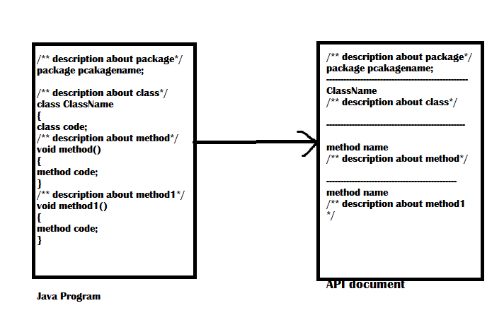
API Document

Slide 6
Starting of a Program
/* This is my first java program
* To display a message
* Author: Core Java Team
* Version v1.0
* Project Title: Programmers challenge
* Project code : 12345 */
package com.ravi.in;
import java.lang.String;
import java.lang.System;
//import java.lang.*;
public class First_Program {
public static void main(String[] args) {
System.out.println("Welcome to Java");
}
}

Slide 7
Importing classes
Suppose in C/C++ program, the first line will be #inculde<stdio.h>----→ Header file.
Like in java------importing classes first.
Programmers interested in two things:
1)Using the classes by creating objects in them
2)Using the methods of the class.
Methods are available in classes and interface.

Slide 8
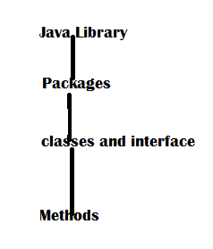
Importing classes
Note:
If programmer want to use a
Class, then that class should be
Imported into his program.
Same as case with methods.
Import java.lang.System
Import java.lang.String
Or import java.lang.*------ imports all classes & interfaces of that package.

Slide 9
Interview questions
What is the difference between #include and import statement?
a)#include directive makes the compiler go to the C/C++ standard library and copy the code from the header file into the program. As a result, the program size increases, thus wasting the memory and processor’s time.
b)import statement makes the JVM go to the Java standard library, execute the code there, and substitute the result into the program. Hence no code is copied and hence no waste of memory or processor’s time. So, import is an efficient mechanism then #include.

Slide 10
public static void main(String args[])
In java we cannot write a java program with out a class. Atleast one class is required.
Execution starts from the main method.
JVM will call the main method.
A method is executed only when we called. But how to call. We are having 2 steps in java.
Create a object to the class which the methods.
Classname objectname= new classname();
2)The method should be called using the objectname.methodname();

Slide 11
We can understand that an object should be created only after calling the main() method.
For calling main method we need an object. But it is not possible to create object before calling main().
Then how should call the main() method with out creating a object?
Such methods are called static methods.
Static methods are called without creating a object.
So that’s why we are kept main method as static.
Static main method called by classname.methodname();
First_Program.main();

Slide 12
Interview questions
What happens if String args[] is not written in main method?
A)when main() method is written with out String args[] as:
public static void main()
The code will compile but JVM cannot run code because it cannot recognize the main method as where execution starts. Remember always JVM looks for the main method with string type array as parameter.

Slide 13
Formatting the output
public class FirstProgram {
/**
* @param args
*/
public static void main(String[] args) {
int x=10;
int y=20;
int z;
z=x+y;
System.out.print(x+y+"Sum of two numbers :");
System.out.println(z);
//System.out.print(z);
}
}

Slide 14
Important point
Print method cannot display more than one value.
If two values, like a string and a numeric value need to be displayed using a single print() method, we should use + operator to combine.
System.out.println("Sum of two numbers :"+x+y);
The output will be 1020. because the first left datatype in print() method is string so rest other variables also it converts into strings.

Slide 15
System.out.println("Sum of two numbers :"+(x+y));
This will give required output as execution starts from the inner braces.
System.out.println(x+y+"Sum of two numbers :");
This also executes fine.

Slide 16
What is the difference between print() and println()
Both methods are used to display the results on the monitor, print() method displays the results and then retains the cursor in the same line, next to the end of the result. println() method displays the result and then throws the cursor to the next line.

Slide 17
Back slash code or escape sequence
Back slash code | Meaning
\n | Next Line
\t | Horizontal tab space
\r | Enter Key
\b | Back space
\f | Form feed
\\ | Displays \
\” | Displays *
\ ‘ | Displays ‘

Slide 18
To understand the effect of print() and println() methods.
public class SecondProram {
/**
* @param args
*/
public static void main(String[] args) {
// TODO Auto-generated method stub
int a =1,b=2,c=3, d=4;
System.out.print(a+"\t"+b);
System.out.print(b+"\n"+b);
System.out.print(":"+c);
System.out.println();// cursor throws in next line
System.out.println("Hello\\Hi\""+d);
}
}

